Slide 1
Data, Environment and Society Lecture 4: More pandas
September 4, 2018
Instructor: Duncan Calllaway
GSI: Seigi Karasaki

Slide 2
Announcements
Lab 1 due last Friday
Lab 2 due this Friday
I understand there is a problem with the baby names data set – we will get back to you today.
HW1 due today
Need to run notebook up to the point of the “broken cell”
…then run everything after that cell.
HW2 due next Tuesday

Slide 3
Today…
We’ll keep working with pandas. Key ideas
Merging data frames
Logical indexing
‘groupby’
See ipynb files in github repo
We’ll talk a little about the data sets in HW2
Baby names
Air quality data
I’ll use this ppt for that discussion.
I am going to postpone reading discussion to Thursday
This lines up better with the content of that lecture
And gives us more time to discuss pandas and the HW data sets today

Slide 4
EPA air quality data
Here is a link to the source page.
Sources of PM
Many sizes and shapes and can be made up of hundreds of different chemicals.
Some directly from a source: construction sites, unpaved roads, fields, smokestacks or fires.
Most form in the atmosphere by complex reactions of chemicals such as sulfur dioxide and nitrogen oxides

Slide 5
More on PM2.5…
(text adapted from epa.gov) Health effects:
premature death in people with heart or lung disease
nonfatal heart attacks
irregular heartbeat
aggravated asthma
decreased lung function
increased respiratory symptoms, such as irritation of the airways
Environmental effects
makes lakes and streams acidic
changes the nutrient balance in coastal waters and large river basins
depletes soil nutrients
damages sensitive forests and farm crops
affects the diversity of ecosystems
contributes to acid rain

Slide 6
PM2.5 monitoring
Go here to see cool maps
And go here to see a list of locations
But, how many sensors?
Oakland has three
Berkeley has one, near the Marina
However as you may imagine, pollution is much more heterogeneous…

Slide 7
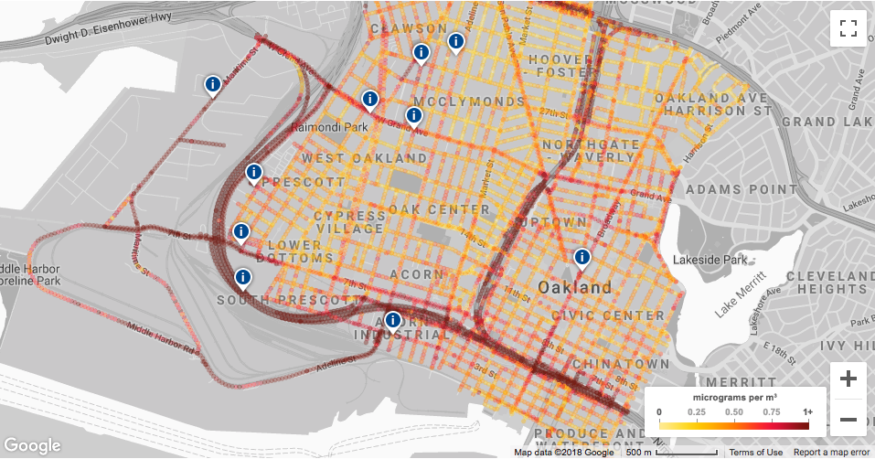
Example: Improving air quality assessments
Josh Apte (ERG PhD alum) partnered with Google, Environmental Defense and West Oakland Environmental Indicators Project to generate air quality data of unprecedented resolution

Slide 8
PurpleAir…
…sells internet-connected air quality sensors
Here is a map of where we live:
https://www.purpleair.com/map#11.53/37.82/-122.2063

Slide 9
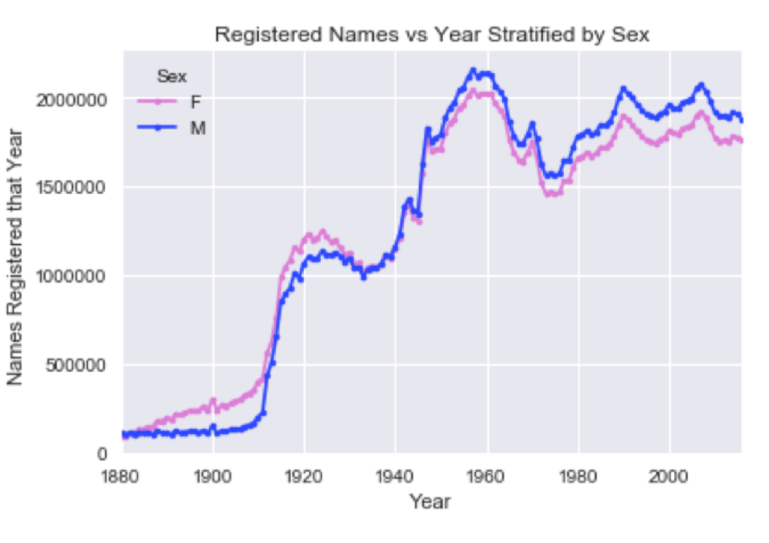
Baby names data set…
Taken from US social security registrations
System created in 1937
Do they form a census?
Does not include most people born before 1937
Does not include all people that move to the US after they are born
Uncommon names (less than 5 times) withheld
Privacy reasons

